Slide 1


Single Board Computer Clusters for Dummies
By: Alex Bissessur

Slide 2


Who am I?
HSC Student at CSE
Tech/Linux Enthusiast
Raspberry Pi Fanatic
Python Nerd™
My aspirations
Sharing my knowledge
Artificial Intelligence
Linux Sysadmin

Slide 3

Topics to be covered:
Why you would opt for cluster computing?
What is Kubernetes?
What’s up with Single Board Computers?
How to setup your own cluster in an hour!
Why you would want one +
Facilities provided by clustering
Grounding ourselves

Slide 4


Slide 5
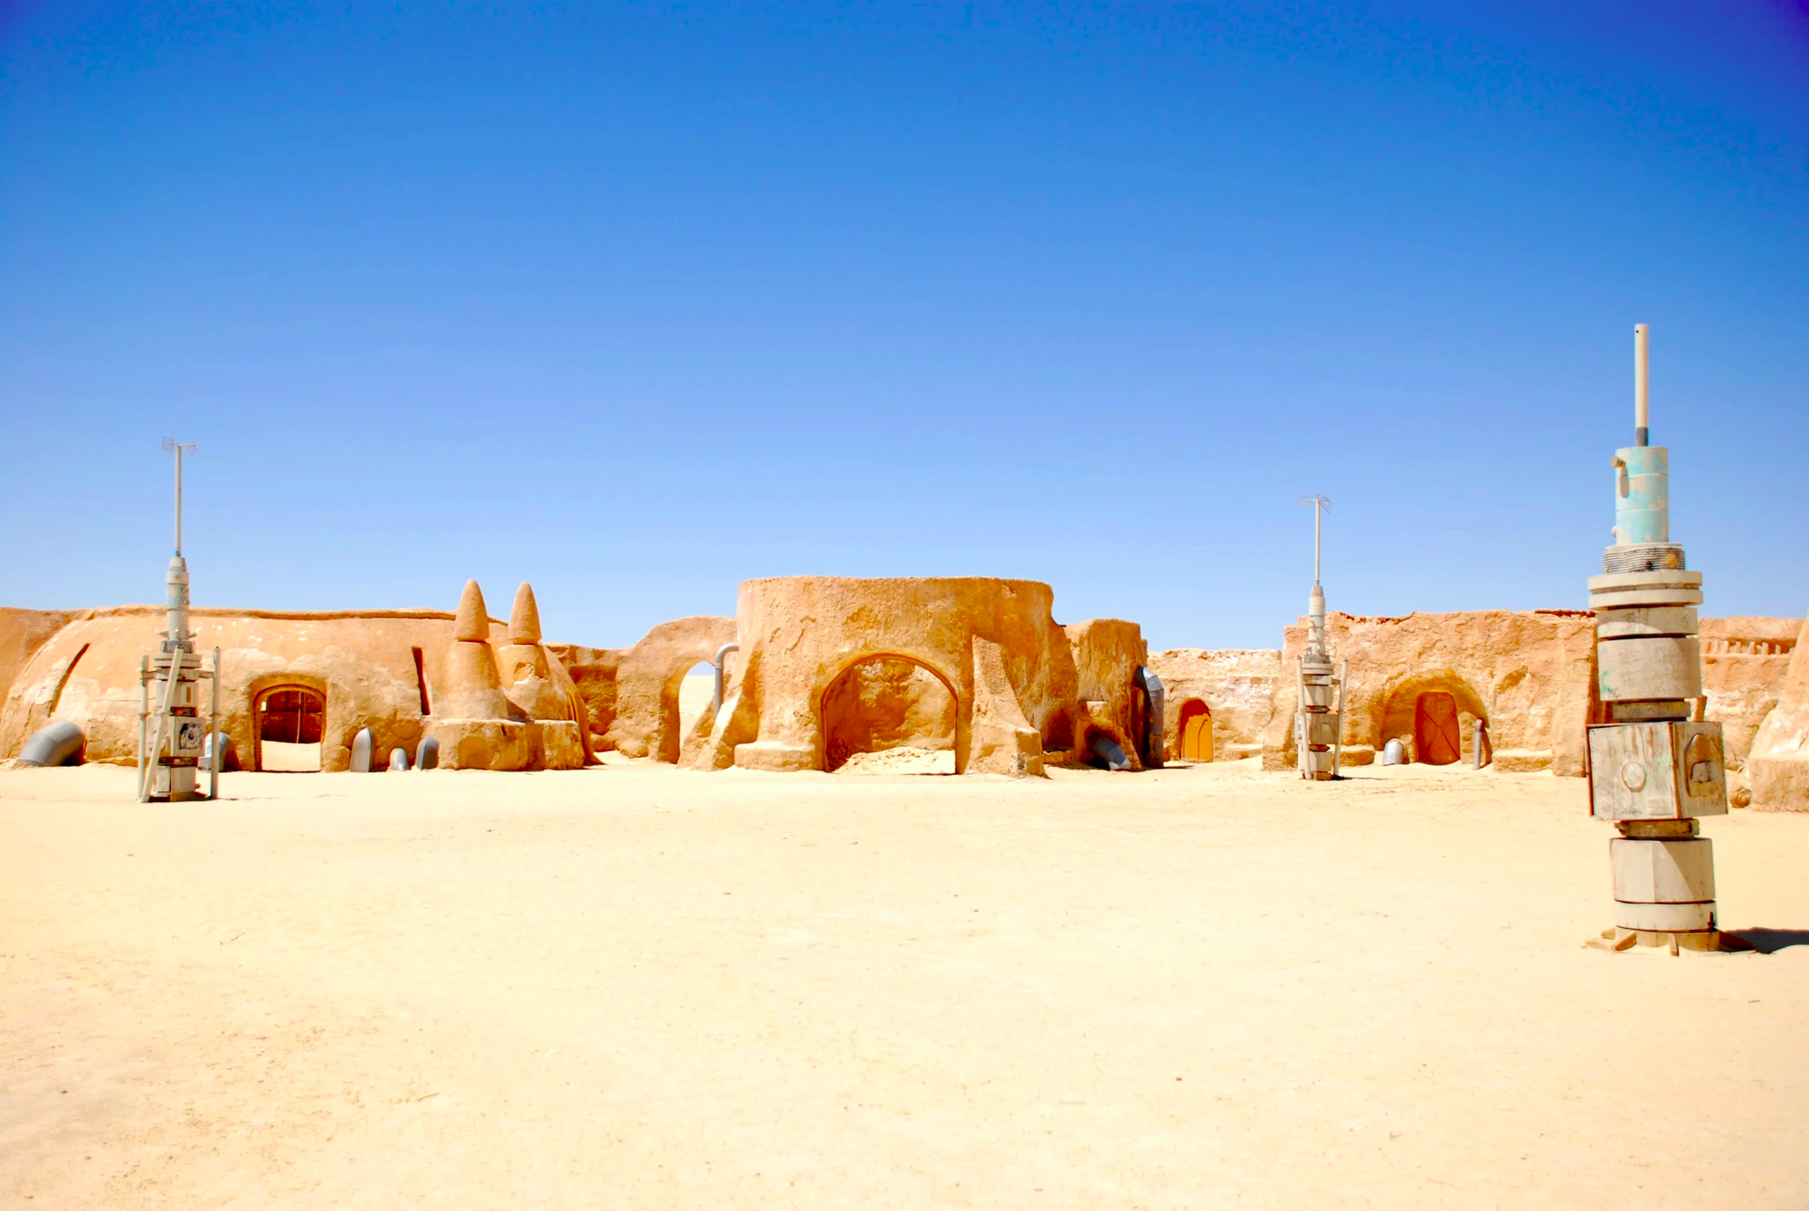
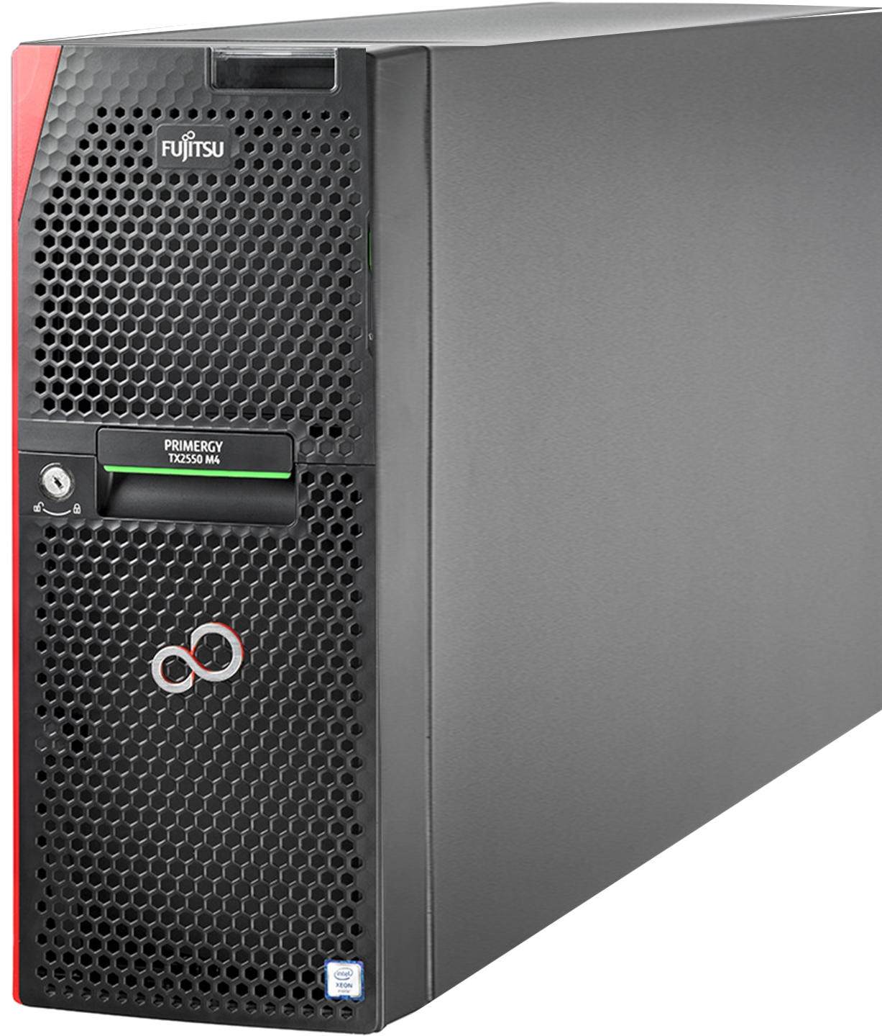

Slide 6

Why Cluster Computing?
Single computer has limited hardware upgradability.
Expand sideways, not downwards.
Netflix serving content from a single server is nuts.
Redundancy from having several servers.
Use of clusters ≡ microservices architecture.
Better upgradability, availability and portability
Notes:
- Compare to my PC at home, can only upgrade so much

Slide 7
Kubernetes?
Industry standard of cluster computing.
“pod” – smallest unit of Kubernetes. Usually holds 1 container.
Automatic load balancing across nodes.
Simple scaling of applications.
Exposure of ports and IP addresses of pods.
Restarts/moves pods automatically.
Notes:
- Industry Standard
One of the most prominent for cluster computing
Google, now OS. Meaning in Greek
Alternatives: Apache Mesos, Docker Swarm, Nomad & Hadoop for big data
- Pods
Smallest unit of Kubes
- Load Balancing
Share work Distribute work to different nodes
- Scaling of Apps
Inc/dec pods depending on demand
- Exposure of ports and IP addresses
Easy port mapping, as with docker
- Can restart and move pods
Restart dead pods
Move pod if node dead

Slide 8
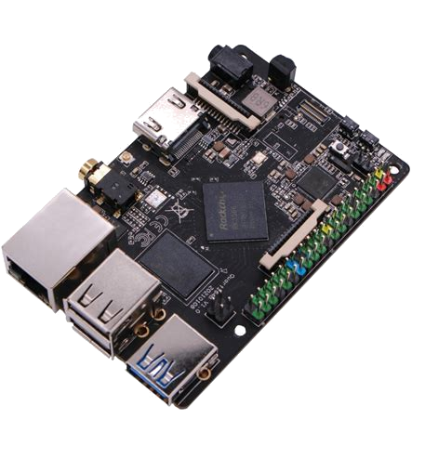
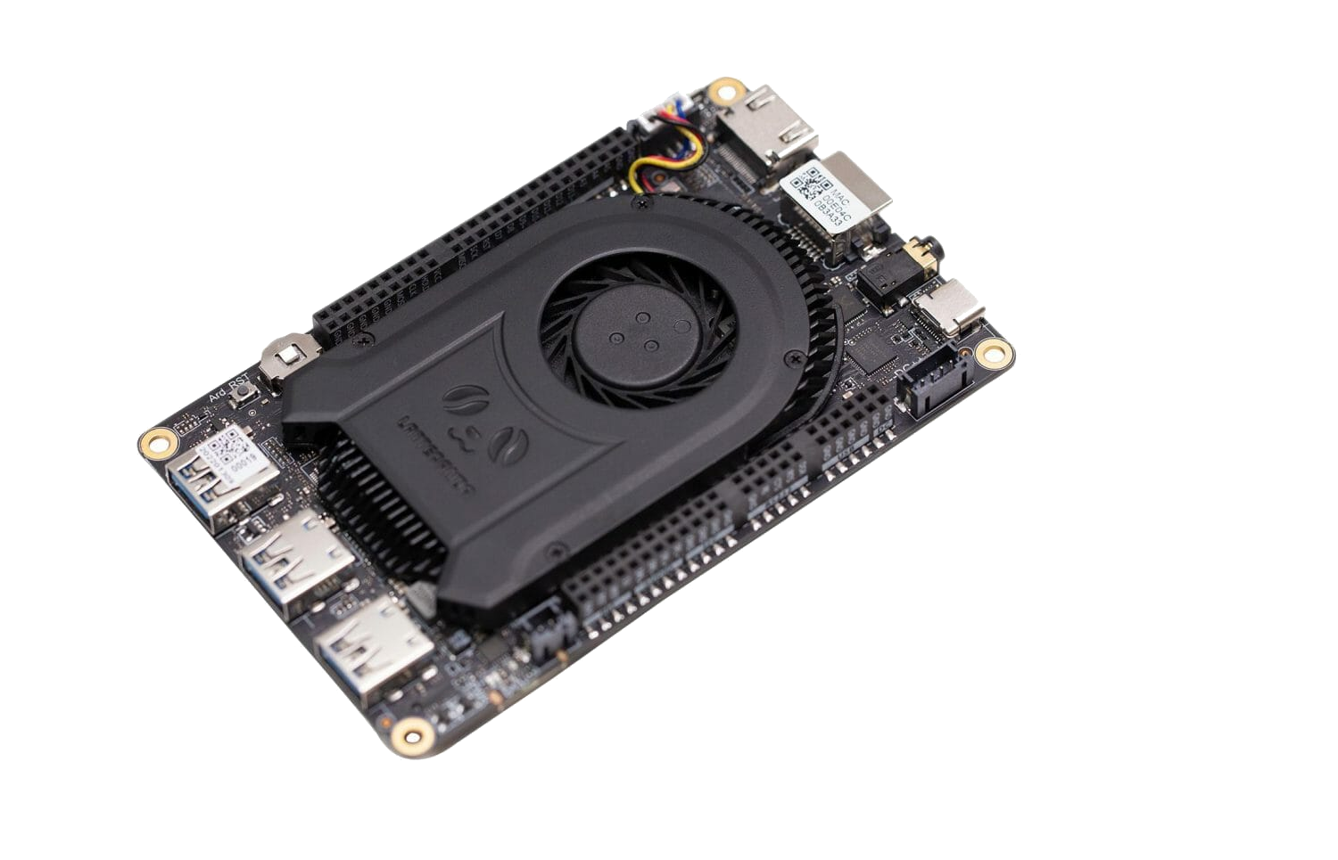
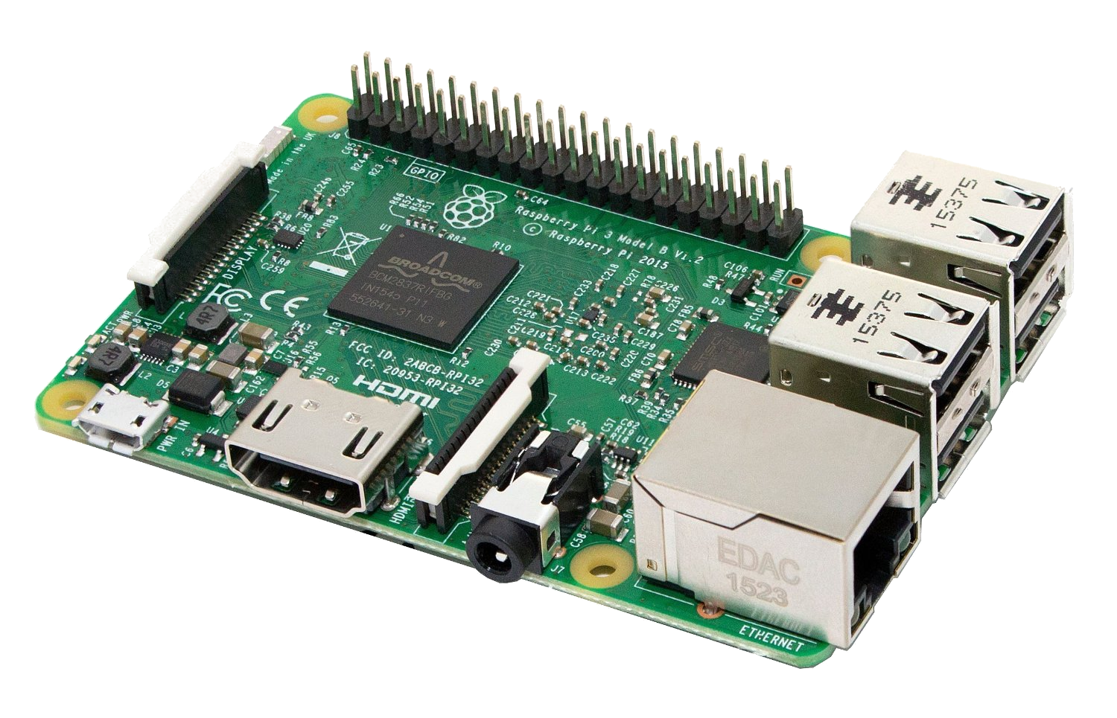
Single Board Computers?
They are computers on a single PCB, like the Raspberry Pi.
Typically ARM based.
Many manufacturers such as Pine 64, Le Potato, Khadas, Lattepanda.
Technically been around for a long time with Acorn or BBC Micro.
Notes:
- Computers on a single PCB, everything included
- Think Raspberry Pi, credit card sized.
- They have been around for longer, when PCs were just coming up
- Typically ARM processors, but a few do sport x86
- Intel Celeron mainly
- Many new competitors, a lot of choice in SBCs now

Slide 9
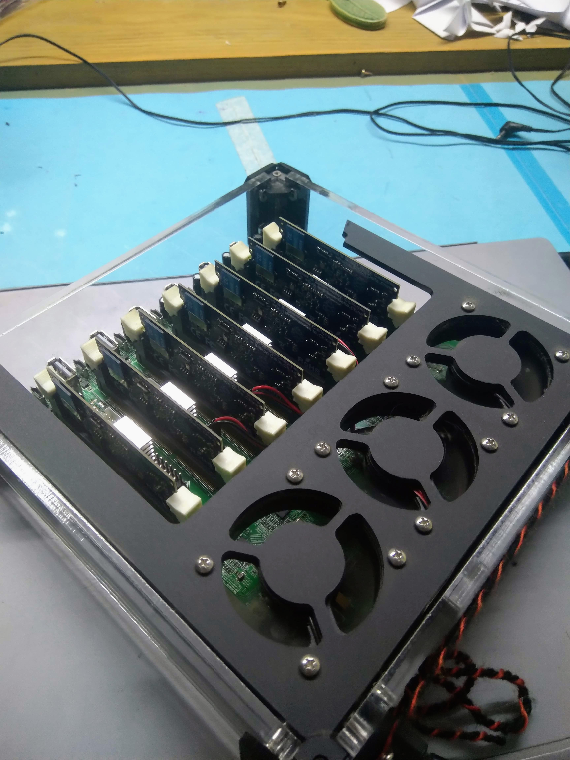
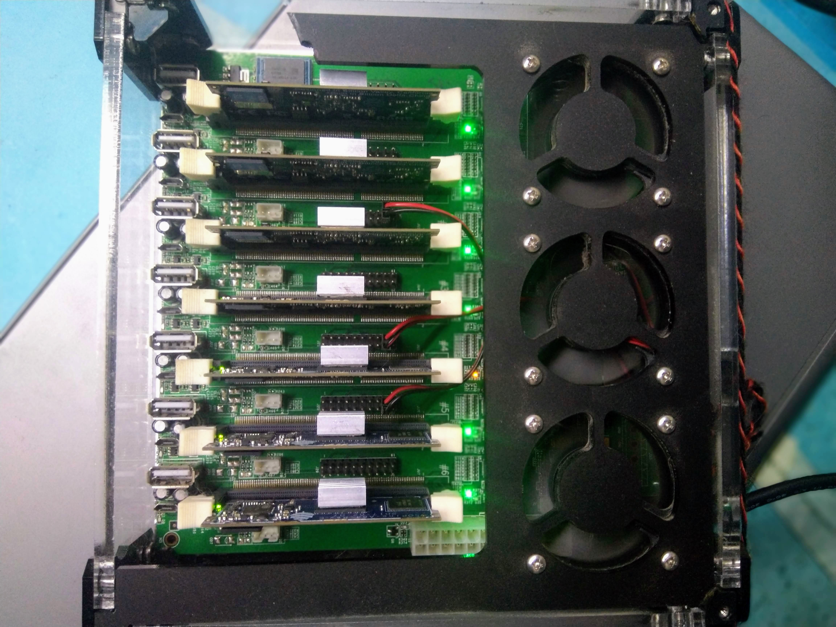
Notes:
- Computers on a single PCB, everything included
- Think Raspberry Pi, credit card sized.
- They have been around for longer, when PCs were just coming up
- Typically ARM processors, but a few do sport x86
- Intel Celeron mainly
- Many new competitors, a lot of choice in SBCs now

Slide 10
Benefits
Drawbacks
No monthly fees (except electricity)
Lower electricity costs vs desktop/server PC.
Cheap to own vs actual servers.
Relatively powerful, especially the Pi 4.
Raspberry Pi shortages & scalping.
Low expandability / upgradability.
Xeons, ThreadRippers & Ampere exist.
Notes:
- Once you own the cluster, it’s yours.
No monthly fees from cloud infra providers.
Only cost is electricity
- Lower electricity costs vs clustering old Pcs/servers
Lower performance per watt but lower electricity by far
- Cannot upgrade hardware on SBCs
No NVME’s, graphics cards etc
- Higher power server-specialised CPUs exist
Admittedly cost a lot more – depends what you look for
16 cores – AMD Epyc > $1000 ; 4 Pi’s <= $500
- Software may not be compatible with ARM processors Thx Apple.

Slide 11
Pre-requisites for Kubernetes
Install OS by downloading the .iso; flashing the micro SD’s with Balena Etcher.
OS: Ubuntu Server / RasPi OS / Armbian / Arch
Figure out your cluster architecture. Things to consider:
- Number of master nodes
- Designated storage nodes
Notes:
- Some already familiar with SBCs and setting them up
- Starts with flashing an OS onto the micro SD
- Usually boot from micro SD
- Use Balena Etcher for that, reliable
-Plug SD card in and do first-run config
- Use different hostnames btw, my experience
- Should also think of architecture
- If you will go for blue/green deployment
- How you will do storage – SQL server maybe
- Redundancy for Master Nodes

Slide 12
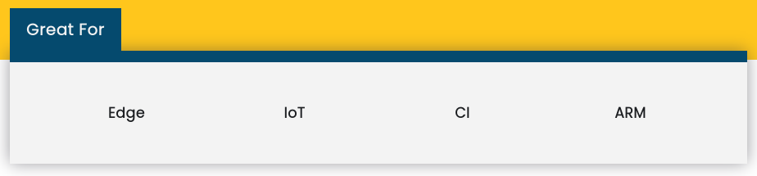
Kubernetes Flavours
K8S is too resource-hungry for SBC’s
Lightweight version – K3S – fully certified distribution of Kubernetes. Created by Rancher Labs.
Full support for ARM architecture.
Marketed as compatible with anything from a Raspberry Pi to a fully fledged server.
Notes:
- Kubernetes – usually mean K8S.
- K8S isn’t all there is as Kubernetes options
- MiniKube, K3S also exist
- I used K3S – made and distributed by Rancher Labs
- More lightweight, SBCs have limited resources
K8S would not leave much for everything else
- Fully certified, fully functional, just like K8S
- ARM architecture support, marketed towards SBCs like the Pi

Slide 13
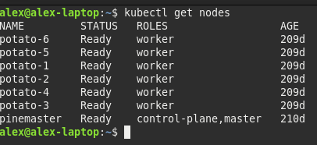
Installing K3S
Rancher Labs provides an Ansible playbook for easily installing K3S.
First encounter with .yaml files.
- Set the master and worker nodes.
- Can set by IP or hostname.
- Ansible does configuration automatically
Process automated but takes some
time.
Can fetch nodes and pods once done
Notes:
- Fairly Simple really
- Rancher Labs provides Ansible playbook
- All you need to do is set some parameters and run
- Ansible is a means of automating configuration and widely used in devops
- Need to pass parameters in .yaml file
- Declare master & worker nodes
- First encounter – integral part of Kubernetes

Slide 14
But Wait!
Monitoring essential part of cluster.
- Check CPU temperature, usage; ensure nodes working properly.
Prometheus & Grafana are standard self-hosted solutions.
Node exporter sends data to Prometheus.
Prometheus gathers data from all nodes.
Grafana displays pretty graphs on a web interface.
Notes:
- Cool, you have your cluster now
- Before deploying your apps to it, need to add monitoring
- Essential! Monitor temperatures, load, storage
- Everything which could go wrong
- Prometheus and Grafana typically used for this
- Works with Node Exporter
- Node Exporter on all nodes
- Fundamentally, Node Exporter gathers data
- Sends to Prometheus which runs on a single node
- Grafana gets aggregated data from Prometheu
- Uses it to display graphs on web
- Grafana also on single node

Slide 15
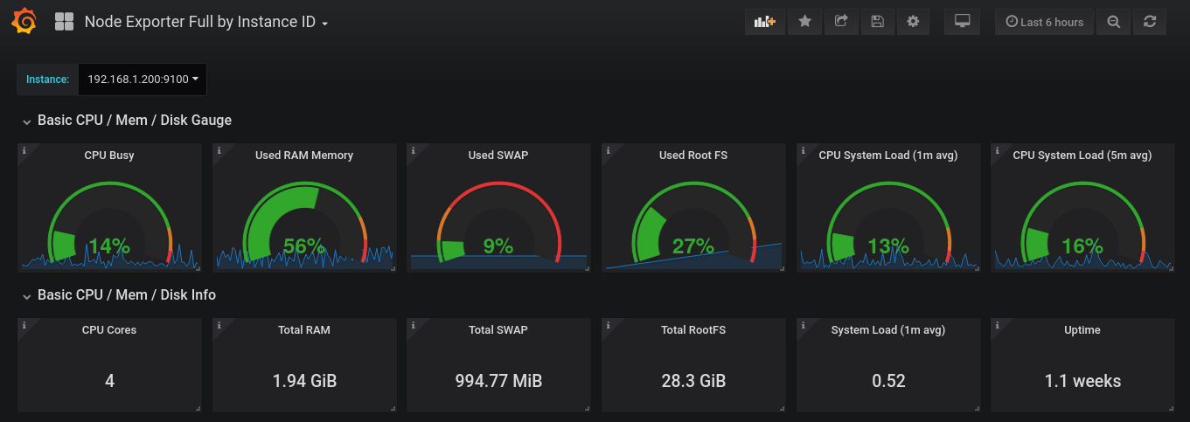

Slide 16
Installing Prometheus & Grafana
Can be installed as pods on the individual nodes.
Prometheus recently got ARM support.
Or, install Prometheus and Grafana as a service and set the service to run on boot.
Download suite from Github.
Add ipTables rules.
Set to run on startup.
Notes:
- Usually, you can go with installing the Node Exporter pods
- Didn’t work in my case
- Ended up installing as services, just as easy.
- Download the files
- Run at startup
- Just miss out on having it containerised
- Advantage is if K3S gets messed up, monitoring stays online
- Essential for diagnosis

Slide 17

What Can I Do Now?
Game Server (friends not included)
Web Server
Self Hosting (eg: PiHole)
IoT – large IoT ecosystem around SBCs
Edge Computing
Testing (ARM deployments)

Slide 18
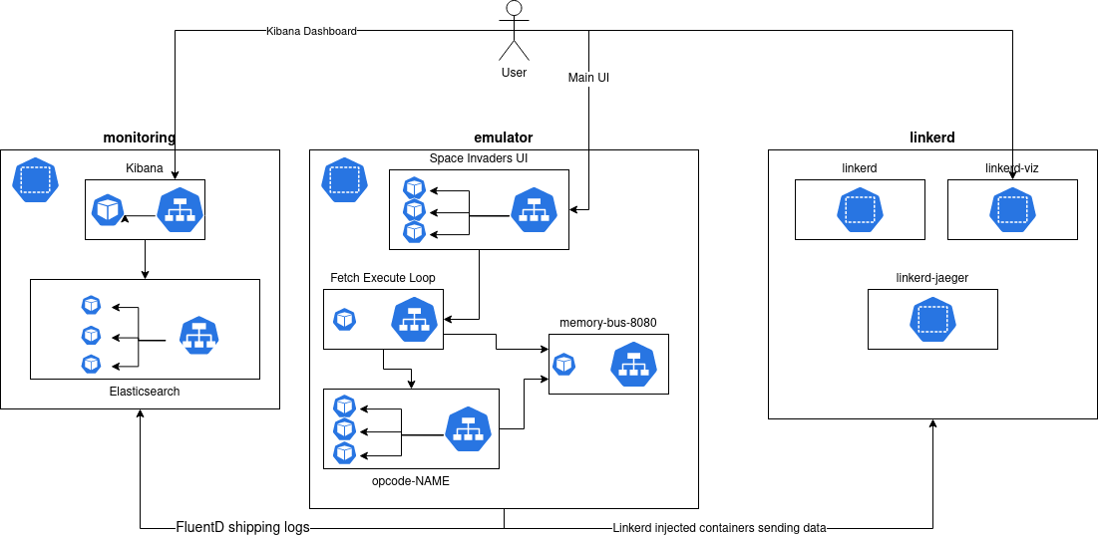
Or… Whatever this is...
Notes:
- I encountered this yesterday…
- It’s to run Space Invaders on a cluster
- In particular, it runs on an emulated 8080 processor
- Each pod is one instruction
- Honourable mention because it’s insane

Slide 19

WHY YOU WANT ONE

Slide 20
Redundancy & High Availability
Hardware or software failures would affect services in a monolith system.
Pods are detached from node so can be moved around.
Ensures minimised downtime & uninterrupted service.
Objective is to minimise impact of failures.
Notes:
- Hardware/software failures would usually impact services.
- At home, PiHole on an Rpi. If Pi dies, I will see ads, which is a fate worse than death
- Cluster computing reduces the flaw of monolith
- Pods can be moved around immediately by the master
- If a worker dies, pod moved around to keep running
- Minimise downtime & uninterrupted service
- Would be bad for a bank to be down for even just an hour on peak
- Minimise impact of failures
- One server is on fire?
- Just move the pod somewhere else

Slide 21
Orchestrate Distribution
Deployment: Specifies properties of the service.
ReplicaSet: Automatic scaling up and down of pods.
Service: Abstraction for load balancing and automatic discovery of pods.

Slide 22
Orchestrate Distribution
Scheduler: Load balancing and moves pods around to make best use of resources.
Labels & Selectors: Classification and ease of management of pods.
Closed feedback loop to ensure quality of service.

Slide 23
Blue Green Deployment
Upgrade pods/OS in batches.
Traffic redirected away from one batch.
Upgrade & test before redirecting traffic back.
Blue batch runs current version. Green runs the upgraded version.
Notes:
- Method of organising your containers to avoid downtime during upgrades
- Monolith, upgrading, systems offline temporarily
- Cluster, upgrade nodes separately, in batches
- Redirect traffic away from one batch
- Upgrade and test batch for stability
- Redirect traffic back
- Blue runs current version, green runs updated version
- No downtime, service remains accessible
- Compare Mc Donalds – 2 in a city.
Both need renovation
Close only one at a time for renovation, the other provides service

Slide 24
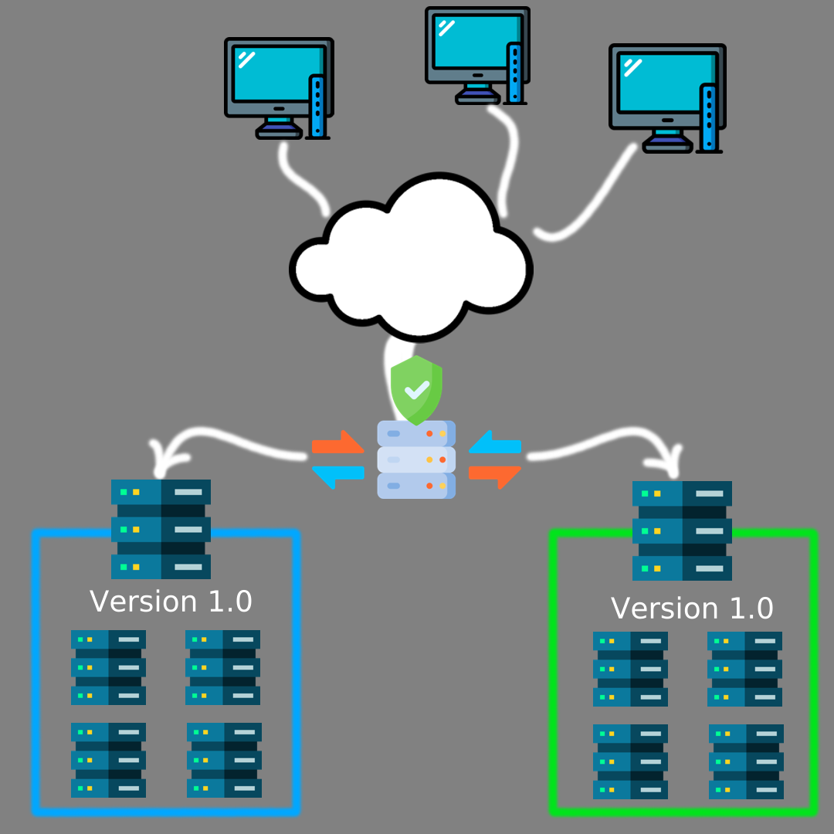

Slide 25
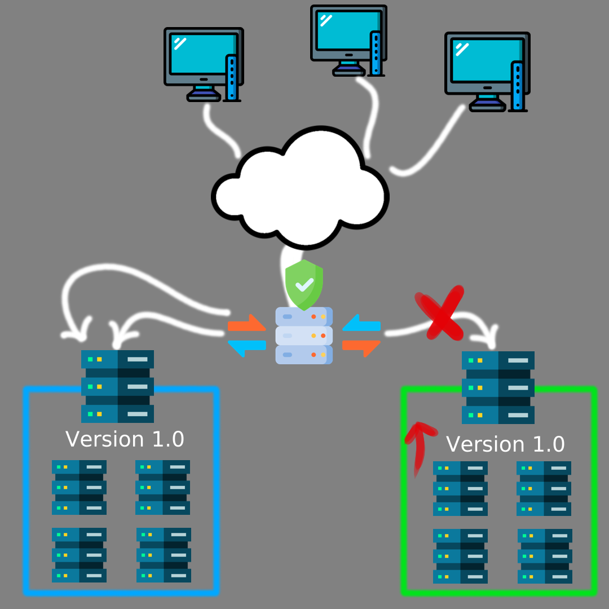

Slide 26


Slide 27
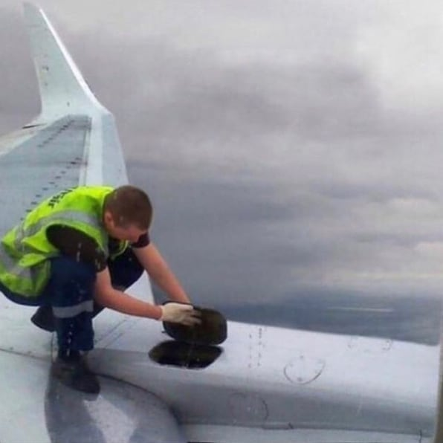
Blue Green Deployment (Simplified)
Notes:
System never goes offline during upgrades.
No downtime, compared to monolith deployment.

Slide 28
Proof of Concept & Testing
Streamlined Proof Of Concept :- S.P.O.C
Minicluster allows trialing of new concepts.
- Avoids cost incurred with a fully fledged test environment.
- Useful for hobbyists or people trying something out on the side (or a second test env).
Performance can be evaluated locally.
Deployment scalable, easily portable to cloud.
Notes:
- Enterprises have full testing infra for trialling changes
- Mum has like 5 full servers just for testing
- And hobbyists / people on a budget don’t even have dedicated testing
- At best, trial something in VM for a bit
- Minicluster – test new concepts
- no need to spend on full test environment, with powerful servers
- Second test environment to test something new
- If you break something, no problem, just reflash the OS or just reinstall K3S
- Can evaluate performance locally, test stability etc…
- Built around microservices, easily scalable
- Portable to cloud or other servers as you may need

Slide 29
Not Convinced?
SBC’s becoming more powerful & cheaper.
(eg: Radxa Rock 5B / LattePanda Sigma / Zimaboard)
Raspberry Pi committed to restoring production volumes to pre-pandemic.
Influx of Pi 3’s on the second hand market.

Slide 30
STILL Not Convinced??
Beginner friendly – RPi community
Low power – not like a PowerEdge under your bed.
Decent power for personal use – game servers, website, self hosted services ...
Educational & Fun
Easy to build, rebuild & reconfigure

Slide 31
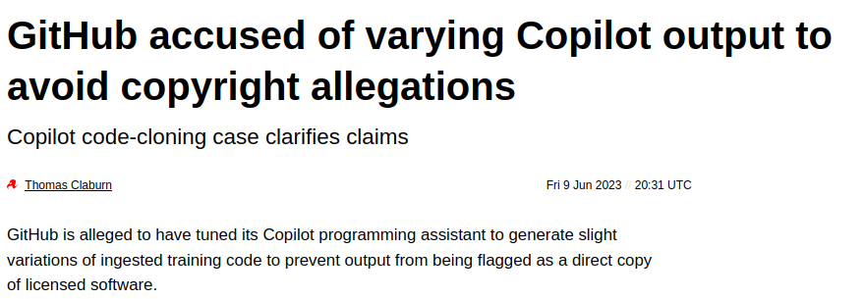

Nearly There?
You own your data
Better privacy when you own everything. Your own cloud, mail server, search engine...
Personal data is now worth a lot to train AI or just surveillance.

Slide 32
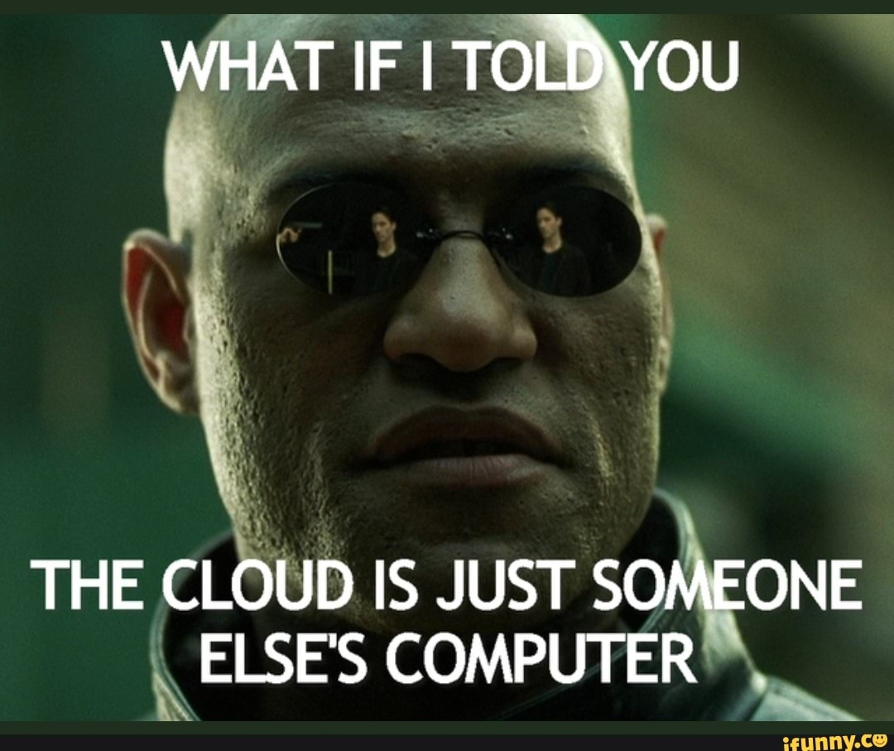
And Finally...
There are no servers in the cloud

Slide 33
Minicluster Limitations
Resources not added in a cluster. 4 nodes of 2GB RAM =/= 1 node of 8GB RAM.
A pod cannot be subdivided further for several nodes.
System architecture must be well optimised
Poor graphics performace
Software not packaged for ARM processors.
Low expansion/customisation – No SATA/NVME/PCIE
Notes:
- Same failing points as single SBCs
- In a cluster, you can’t think of it like adding resources. 4*2 not same as 1*8
- Resources may get cramped when using SBCs
- Cannot break a pod down further. If a pod cannot run on one SBC, cannot run on the cluster.
- Architecture must be well planned & optimised.
- Poor graphics, cannot use for AI or render farms
- Software not be packaged for ARM, so won’t run
- SBCs have limited expansion or customisation. No NVME, no upgrade RAM. Reduced redundance of parts (no 2 PSU)

Slide 34
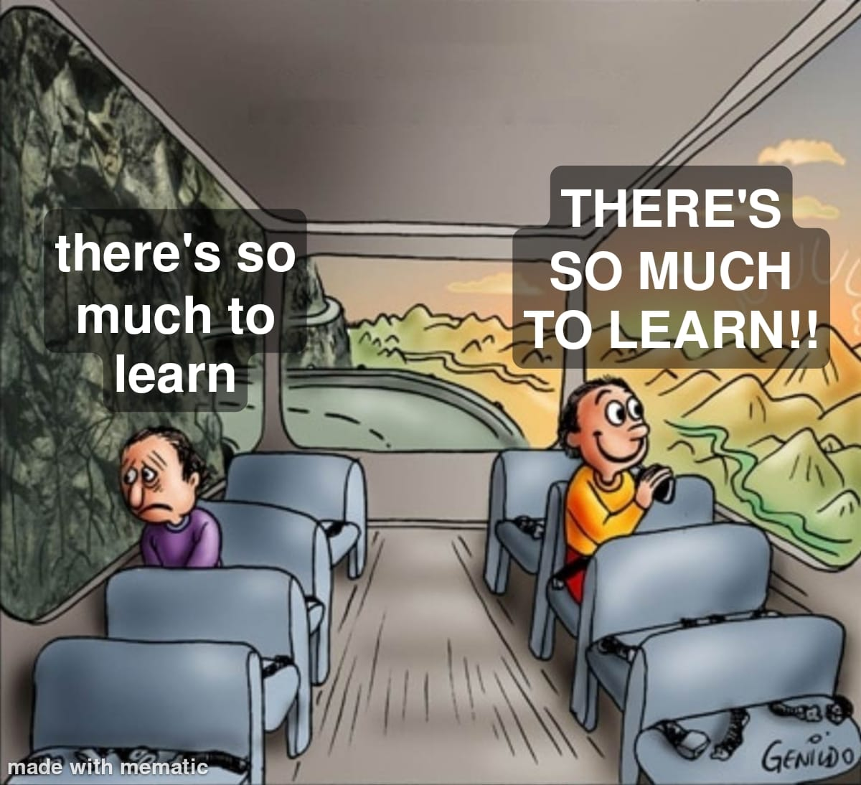
Notes:
You can be either the person on the left or the person on the right regarding Kubernetes and the amount to learn.
As for me, I am contemplating a few goals with my cluster.
Game servers, home assistant, plex server, discord bots, NextCloud, tools to download content
Could install on one machine, but if it dies, everything blows up
I get to remove any machine in the cluster and keep everything working.
The additional effort in Kubernetes – more reliability + ease of management, objectively better than manually managing a bunch of apps on a monolith server – not repeatable, reliable or isolated.
There’s a lot of cool stuff going on, maybe you’ll decide to have a K3S cluster at home or work. You can learn a lot – translate to job.

Slide 35
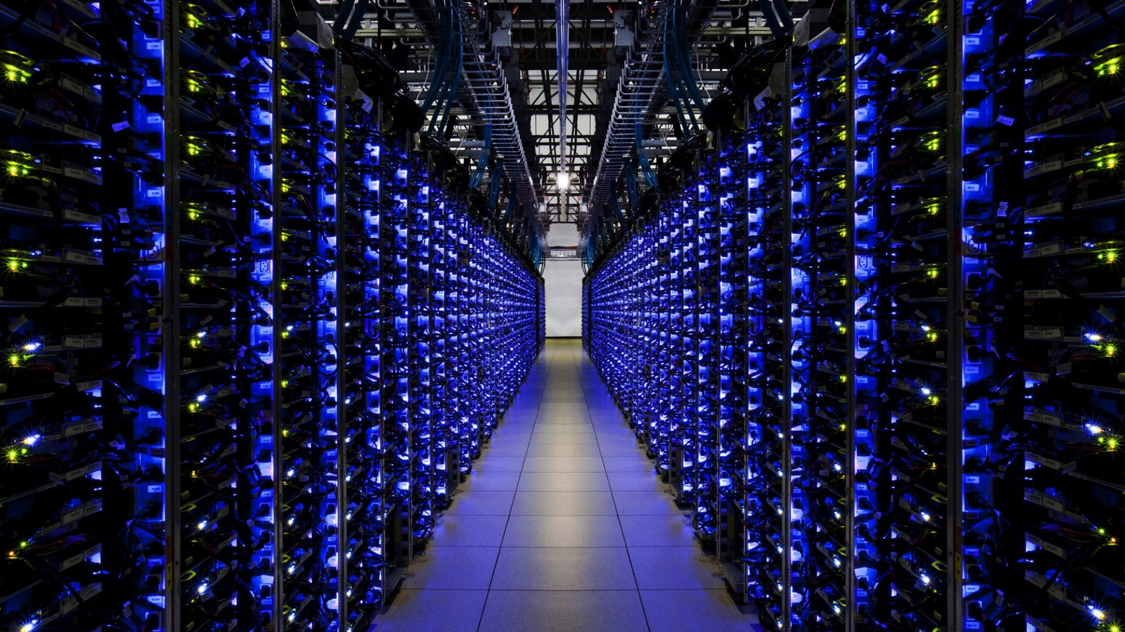
Thank You!
Alex Bissessur
alexbissessur@gmail.com

